Slide 1
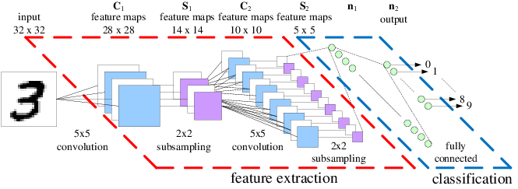
Mastering Convolutional Neural Networks
Theory and Practice in Python
Notes:
1

Slide 2
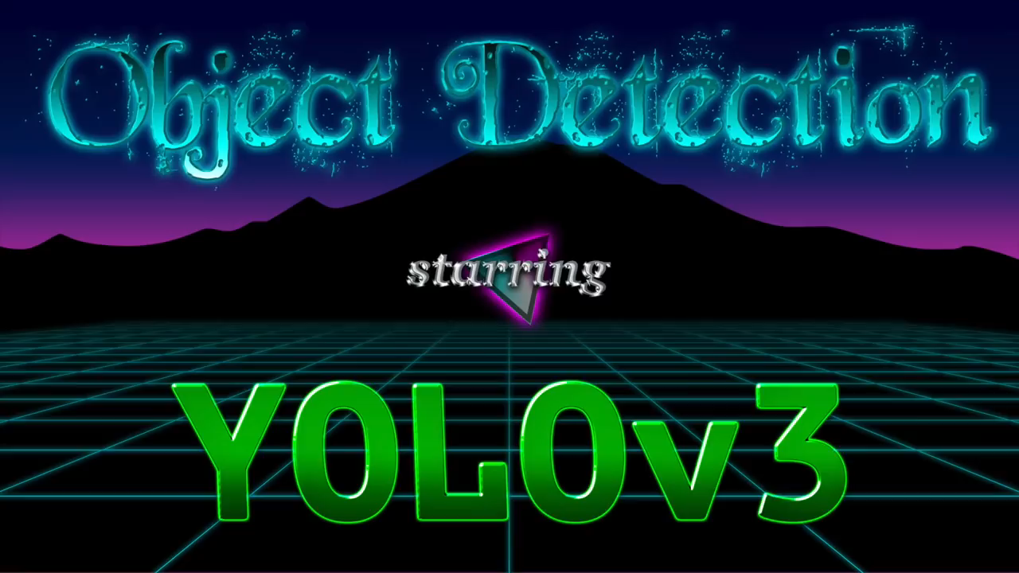
Notes:
2

Slide 3
Focus of the course
Fundamentals
Notes:
3

Slide 4
Focus of the course
Fundamentals
Pythonic
Notes:
4

Slide 5
Focus of the course
Fundamentals
Pythonic
Completeness
Notes:
5

Slide 6
Focus of the course
Fundamentals
Pythonic
Completeness
Recent Models
Notes:
6

Slide 7
Contents
Image Processing
Object Detection
Deep Learning
CNNs
TensorFlow
Transfer Learning
YOLO, Face Verification, Style Transfer,…
Notes:
7

